Slide 1


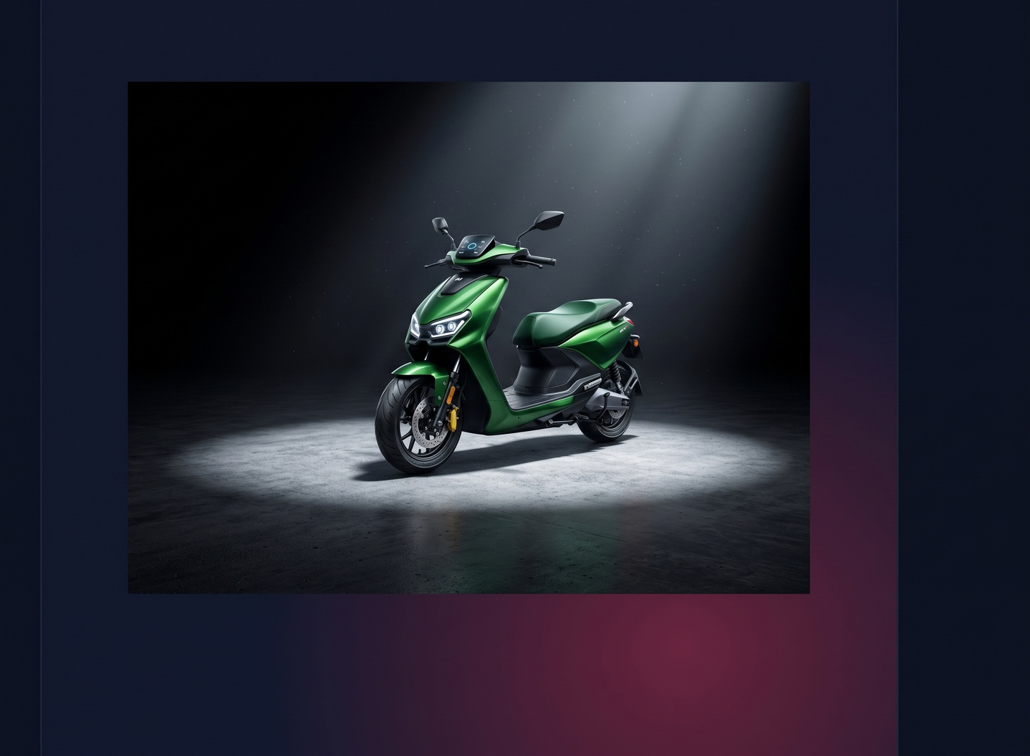
TEAM SYNAPCE |
AeroSense:
Advanced Rider Assistance & Smart Mapping
Transforming commuter two-wheelers into a decentralized road inspection fleet.
The Problem:
  Two-wheelers suffer disproportionately from road surface degradation.
  A pothole bends a car rim, but causes a fatal loss-of-control accident on a stiffly sprung scooter.
  Municipal councils lack real-time data to patch depressions early.

Slide 2
The Core Innovation
Concept: A low-cost edge-computing module that passively crowdsources road hazard locations.
01
02
03
04
Sense
Transmit
Map
Resolve
Edge module detects severe road anomalies in real-time.
Sends a lightweight BLE trigger to the rider’s smartphone.
Phone appends GPS coordinates and uploads to the cloud.
Cloud clusters data to generate automated municipal heat maps.

Slide 3

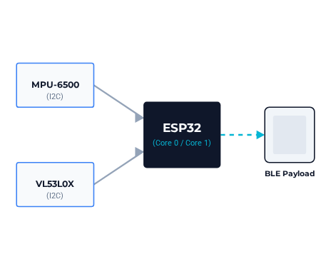
Technical Architecture & Sensor Fusion
Edge Hardware: ESP32 microcontroller utilizing dual-core processing for simultaneous sensor sampling and BLE transmission.
Intelligent Filtering: A hazard is only logged when a sudden ToF depth increase occurs simultaneously with an MPU-6500 free-fall spike, eliminating false positives from cornering.
Dynamic Baseline Algorithm: Maintains a rolling average of distance readings to adapt to gradients without false alarms.

Slide 4



Expanded ADAS Ecosystem
Automatic Crash Detection
Anti-Theft Tamper Alarm
Safe Rider Telematics
Tracks aggressive cornering and harsh braking to generate a "Safe Rider Score."
MPU-6500 detects high lean angles (> 70°) combined with rapid linear deceleration, initiating an automated SOS dispatch.
Gyroscope locks the side-stand tilt baseline; unauthorized leveling triggers a push notification.

Slide 5

Project Timeline & Development
PROJECT INITIATION
NEXT PHASE
September 2026
CURRENT STAGE
Fabrication of a vibration-dampened weatherproof enclosure and development of the BLE-to-Cloud smartphone application.
Breadboard prototype completed. Successful I2C integration of ESP32, MPU-9265, and VL53L0X. Core sensor fusion logic and Dynamic Baseline algorithm functioning.
Hardware Integration
Edge Logic
Cloud & Enclosure
(Complete)
(Complete)
(Pending)

Slide 6
Commercial Viability & Impact
Micro-Budget Hardware: The core sensor array (ESP32, MPU-6500, VL53L0X) costs under Rs. 3,500 per unit to manufacture at scale.
INNOVATION COST
Rs. 3,500
Dual Revenue Streams:
AeroSense Module
•
B2G: Selling targeted maintenance telemetry to municipal councils.
VS
•
B2B: Licensing rider telematics to insurance companies for dynamic premium pricing.
STATUS QUO
Accident Damage
Rs. 40,000+
The Bottom Line: For the cost of repairing a single accident-damaged motorcycle, a local council could deploy a fleet of AeroSense modules to proactively secure an entire urban district.
(Bent rim, suspension forks, & medical bills)

